Slide 1
SCD Task1.1

Slide 2
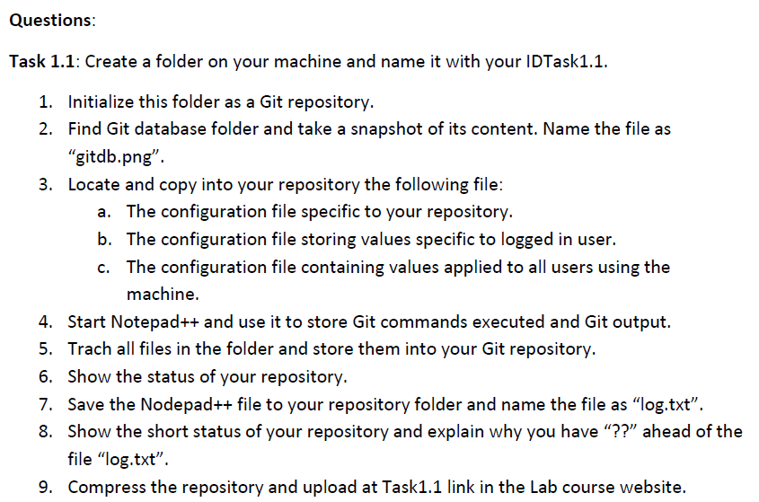

Slide 3
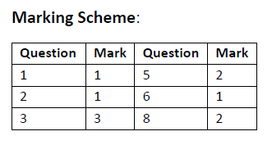

Slide 4
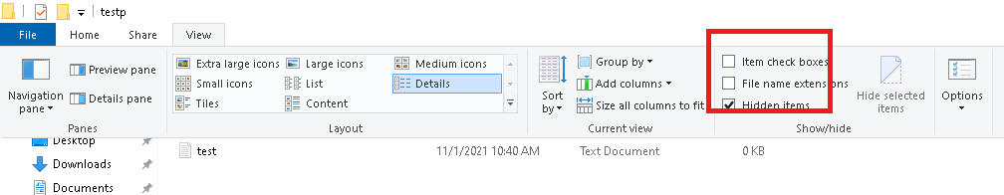
Show hidden files
https://pureinfotech.com/show-hidden-files-folders-windows-10/

Slide 5
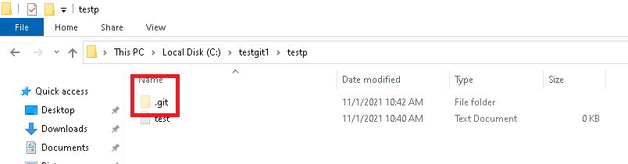

Slide 6
